Slide 1
Osteoporosis Treatment
In The Name of God
Dr.Rojin Farzaneh
Assistant Professor of Rheumatology
May 2021

Slide 2
Osteoporosis treatment
NONPHARMACOLOGIC THERAPY
PHARMACOLOGIC THERAPY

Slide 3
NONPHARMACOLOGIC APPROACHES

Slide 4
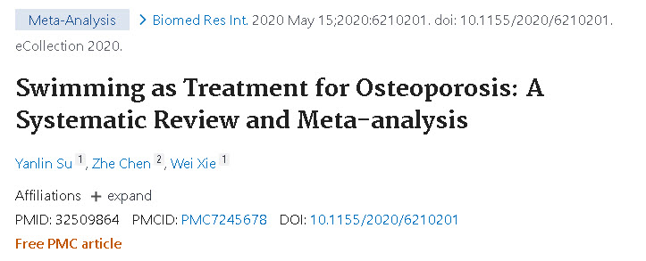
Calcium and Sodium Effects
263 participants. Lumbar spine density was mentioned in three articles. Although the heterogeneity of lumbar vertebral density is moderate, the analysis of swimmers to nonswimmers shows that the lumbar vertebral density in swimmers is improved [heterogeneity: chi² = 5.16, df = 2 (P = 0.08); I ² = 61%]. We analyzed the following heterogeneous subgroups: subgroup 1 (3-6 hours) and subgroup 2 (<3 hours). The BMD in subgroup 1 was significantly higher than that in the placebo, while no effect on BMD was found in subgroup 2 [heterogeneity: chi² = 0.15, df = 3 (P = 0.70); I ² = 0%]
Yalin et al, Meta-Analysis, 2020

Slide 5
weight-bearing vs. non weight-bearing ?
263 participants
Lumbar spine density was mentioned in three articles.
the analysis of swimmers to nonswimmers shows that the lumbar vertebral density in swimmers is improved
They analyzed the following heterogeneous subgroups: subgroup 1 (3-6 hours) and subgroup 2 (<3 hours). The BMD in subgroup 1 was significantly higher than that in the placebo, while no effect on BMD was found in subgroup 2

Slide 6
Sodium Effects
Sodium
relationship between dietary sodium intake and calciuria
On an average, urinary calcium increases by approximately 1 mmol (40 mg) for each 100 mmol (2300 mg) of sodium ingested
One of the mechanisms is (PTH)

Slide 7
Sodium Effects
Sodium
Mild hyponatremia, a common electrolyte abnormality in the elderly
SSRI & diuretic use

Slide 8
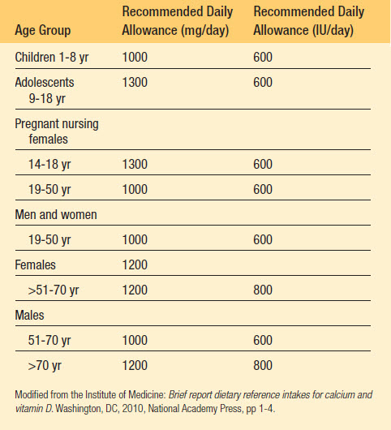
Calcium Requirements Recommended by the National Academy of Sciences (USA)

Slide 9
Calcium
If you are elderly or taking a medicine that decreases
gastric acid, you must take calcium citrate as a calcium
supplement

Slide 10
Calcium
Calcium carbonate contains 40% elemental calcium and should be taken with meals. Calcium citrate, which contains 24% elemental calcium, has better bioavailability and is more readily absorbed with achlorhydria
Studies of calcium carbonate vs. calcium citrate absorbability :depending upon the methodology used to assess calcium absorbability and whether the calcium salts were taken fasting or with a test meal

Slide 11
Calcium
Taking calcium supplements for osteoporosis increases
the risk of cardiovascular disease?!

Slide 12
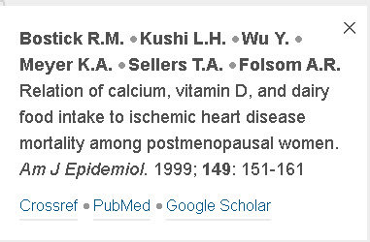
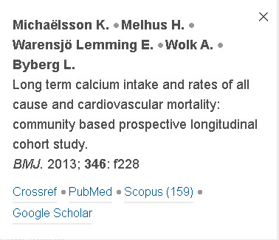
Calcium
In a Swedish prospective longitudinal cohort, calcium intake (both dietary and supplemental) of more than 1,500 mg/day was associated with a hazard ratio of 1.40 (95% CI, 1.17 to 1.67) for all-cause mortality
In contrast, low dietary calcium intake (<700 mg/day compared with 1,400 mg/day) has been associated with increased cardiovascular risks

Slide 13
Calcium
Taking calcium supplements leads to calcium-containing renal stones?!

Slide 14
Calcium
In the absence of kidney stones or an underlying disorder of calcium metabolism, these calcium intakes are safe
The precise recommendations for the prevention of kidney stones depend upon patient’s characteristics as well as the composition of the kidney stone (Taylor and Curhan 2006). Therefore, the dictum that all patients who have had renal stones should not consume dietary or supplemental calcium is usually incorrect

Slide 15
VITAMIN D
Assessment of vitamin D status by measuring serum 25OHD levels is required before initiating pharmacologic therapy.
Serum 25OHD levels should be rechecked after about 12 to 16 weeks of replacement therapy since hypocalcemia may occur in patients with low vitamin D levels

Slide 16
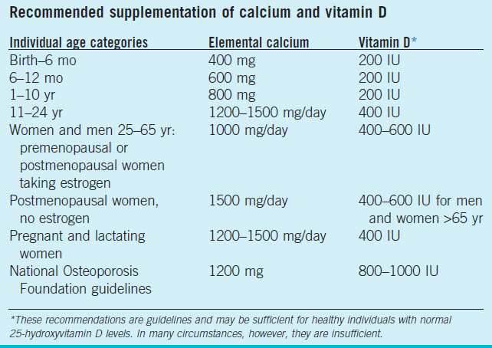

Slide 17
VITAMIN D
Excessive exposure to sunlight does not cause vitamin D intoxication because excess vitamin D3 and previtamin D3 are also destroyed by sunlight
At some latitudes, in the winter months, the sunlight is not suffi cient to produce vitamin D. Exposure to 5–10 min of sunlight on the legs between 10 a.m and 3 p.m in the spring, summer, and fall has been shown to be adequate to prevent vitamin D insufficiency

Slide 18
PHARMACOLOGIC INTERVENTIONS
HORMONE REPLACEMENT THERAPY
Selective Estrogen Receptor Modulators
CALCITONIN
BISPHOSPHONATES
DENOSUMAB
PARATHYROID HORMONE

Slide 19
HRT
general recommendation : HRT should be used only for vasomotor symptoms that occur at the time of menopause. When these symptoms abate, it is recommended that estrogen replacement (consisting of combined estrogen and progestin for women with an intact uterus) be stopped because the perceived cardiovascular benefits have not been substantiated and the cardiovascular disease and breast cancer risk make the benefit-to-risk ratio unacceptable for most women

Slide 20
Testosterone
Men with osteoporosis, hypogonadism, and symptoms of low libido may benefit as testosterone cypionate or enanthate (50 to 400 mg intramuscularly every 2 to 4 weeks) or as a transdermal testosterone replacement patch that is applied to the scrotal area (Testoderm, 4 to 6 mg/day) or elsewhere (Androderm, 2.5 or 5 mg/day)
Most studies find that bone mass increases

Slide 21
SERMs
Tamoxifen, the first available SERM : increase in bone density of the spine over 2 years, with no effect on radial bone density
45% reduction at the hip and 29% at the spine
no change occurred in the risk of ischemic heart disease
Raloxifene approved by the (FDA) for the prevention and treatment of osteoporosis
increased BMD in the lumbar spine by 2.4%, in the total hip by 2.4%
a higher risk for venous thromboembolism, leg cramps, and hot flushes than those given the placebo

Slide 22
Calcitonin
parenteral calcitonin : FDA approvrd for the treatment of osteoporosis in 1984
calcitonin in a nasal spray for the treatment of post-menopausal osteoporosis in 1995.
Parenteral calcitonin (100 IU administered subcutaneously or intramuscularly three times a week or daily) : a small increase in bone mass in the spine and, in some instances, the forearm, particularly in patients with a high bone turnover.
Nasal spray calcitonin : approximately 40% as potent as the parenterally administered drug (e.g., 50 to 100 IU of injectable calcitonin is comparable with 200 IU of nasal spray calcitonin) :(one spray) daily

Slide 23
Calcitonin
also obtain a beneficial analgesic response in the presence of osteoporotic fractures
Recently, calcitonin nasal spray was removed from use in Europe because of a concern that it may increase the risk of prostate cancer in men, but at this time it is still on formularies in the United States

Slide 24
Calcitonin
with preexisting vertebral fractures showed only a modest effect on spinal bone mass, but a 33% reduction in the incidence of new vertebral fractures
No effect of calcitonin on nonvertebral or hip fracture

Slide 25
Bisphosphonates
must be taken on an empty stomach because gastrointestinal absorption is less than 10%
should be stopped in patients who develop upper gastrointestinal complaints or who are unable to be upright after taking\

Slide 26
Bisphosphonates : Alendronate
Alendronate :A once-a-week preparation of alendronate (70 mg) is the most commonly used dose for the treatment of osteoporosis
Doses of bisphosphonates greater than 100 mg typically have higher bioavailability
8.8% and 7.8% increase in bone density in the spine and femoral trochanter, respectively but did not reduce the incidence of clinical fractures in women who had low bone mass but not osteoporosis(without fracture)

Slide 27
Bisphosphonates
For alendronate, approximately 50% of the dose is retained in the skeleton
Patients with impaired renal function and creatinine clearance (<30 mL/ min) retain a greater amount of the dose in the skeleton. This could reduce turnover to a degree that would impair the ability to repair microdamage

Slide 28
Bisphosphonates
Zoledronic acid
approved for :
treatment and prevention of post-menopausal osteoporosis (5 mg once a year)
osteoporosis in men (5 mg once a year)
prevention and treatment of glucocorticoid-induced osteoporosis (5 mg once a year)

Slide 29
Bisphosphonates : Zoledronic acid
Zoledronic acid is the only bisphosphonate studied among patients with recent hip fracture, in whom it was able to successfully reduce the rate of subsequent clinical fractures by 35%, and there was a nearly 30% reduced overall mortality in those patients who received zoledronic acid versus placebo

Slide 30
Bisphosphonates :Zoledronic acid
Adverse effects :
include arthralgias and myalgias; however, these adverse events tend to be less frequent with subsequent infusions
symptoms generally resolving within 3 days of dosing but possibly lasting up to 7 to 14 days. An acute-phase reaction is more likely to occur in patients who have not previously been exposed to bisphosphonates and is less likely to recur with subsequent dosing & are attenuated with acetaminophen and may be more common in younger individuals

Slide 31
Bisphosphonates : Zoledronic acid
both serum calcium and 25-OHD levels should be monitored and deficiencies should be restored to normal levels before treatment
patients should be monitored for hypocalcemia. Both serum creatinine and calcium should be measured before each infusion because the drug is contraindicated if creatinine clearance is less than 35 mL/min

Slide 32
Bisphosphonates : side effects
A definition of ONJ is usually an area of exposed alveolar bonein the mandible or maxilla that does not heal within 8 weeks. Recently ONJ without bone exposure has been reported

Slide 33
Bisphosphonates
1% to 15% in oncology patients taking high-dose IV bisphosphonates. In the osteoporosis patient population, the incidence of ONJ is estimated at 0.001% to 0.01%, marginally higher than in the general population
Risk factors:
glucocorticoid use
tooth extraction,dental implants, or bony surgery
poor oral hygiene
chronic inflammation
diabetes mellitus,
ill-fitting dentures

Slide 34
Bisphosphonates : side effects
It is prudent to do an oral examination and withhold therapy for patients with poor dental hygiene and those planning oral surgery.
Interruption of treatment with bisphosphonates is recommended until the mouth is fully healed. Restarting anti-resorptive drug therapy should be considered based on an individual patient’s benefit and risk

Slide 35
Bisphosphonates : side effects
bisphosphonate discontinuation antecedent to invasive dental procedures ?!
a short break in therapy before dental work less meaningful in terms of a detrimental effect on osteoporosis risk in most settings

Slide 36
Bisphosphonates : side effects
“Atypical” subtrochanteric fractures of the femur have been associated with long-term bisphosphonate use. The incidence after 8 years of therapy is estimated to be 1 in 1000 patient-years with no or few cases described in the first 3 years.
defined as a transverse fracture
patients often have a localized periosteal reaction on the lateral cortex and have prodromal symptoms such as a dull or aching pain in the thigh

Slide 37
Bisphosphonates : side effects
Intramedullary nail placement is necessary for completed fractures
Bisphosphonate discontinuation is necessary if this adverse effect occurs

Slide 38
Bisphosphonates : side effects
Atrial Fibrillation
Uveitis
Fracture Nonunion

Slide 39
Bisphosphonates : side effects
Drug holidays in patients with long-term bisphosphonate therapy : after 5 years of oral bisphosphonate or 3 years of IV bisphosphonate treatment, reassessment of risk should be reviewed. In women at high risk, such as those with low hip T-scores or high fracture risk scores or with previous major osteoporotic fracture, including those who fracture on therapy, continuation of treatment for up to 10 years of oral, and 6 years of IV bisphosphonate, therapy should be considered
The implications of discontinuation of denosumab are very different from those for discontinuation of a bisphosphonate

Slide 40
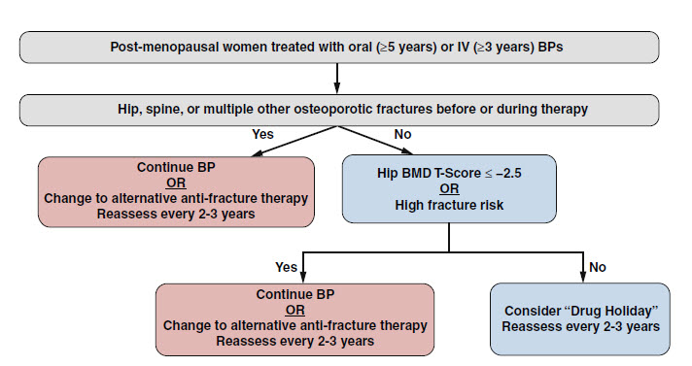
DRUG HOLIDAY

Slide 41
RANK Ligand Inhibitor :Denosomab
a monoclonal antibody that is directed against RANKL
(60 mg subcutaneously every 6 months)
CTX-1 is suppressed by nearly 90% a few weeks after each injection; however, the suppression of bone turnover is transient, and bone turnover and bone density return to baseline levels rapidly if the injections of denosumab are discontinued
serum calcium and 25-OHD should be checked and replaced if needed
adverse events of skin infection requiring hospitalization

Slide 42
Parathyroid Hormone
Forteo is given as a subcutaneous injection daily for 18 to 24 months
experience headache, nausea, and flushing with initiation of treatment, but these adverse effects generally become less severe after a few weeks
two studies found that the combination of PTH and alendronate was less effective in stimulating bone gain at the lumbar spine in both osteopenic women and men over 1 to 1.5 years
in a recent study of denosumab alone, or a combination of PTH and denosumab for 1 year ,combination treatment increased lumbar spine BMD

Slide 43
Parathyroid Hormone
although PTH is an effective monotherapy for increasing bone mass, especially in the spine, the gain in BMD should be maintained with a potent anti-resorptive agent for a number of years

Slide 44
Parathyroid Hormone
Patients with one or more of the following characteristics are appropriate for TPTD therapy:
■ Those who have a significant decline in BMD during antiresorptive therapy
■ Those who are unable to take antiresorptive agents because of side effects
■ Those who sustain a fragility fracture during antiresorptive therapy
■ Those who have multiple clinical risk factors for fracture
■ Patients who are treatment naive and at high risk for fracture

